Slide 1


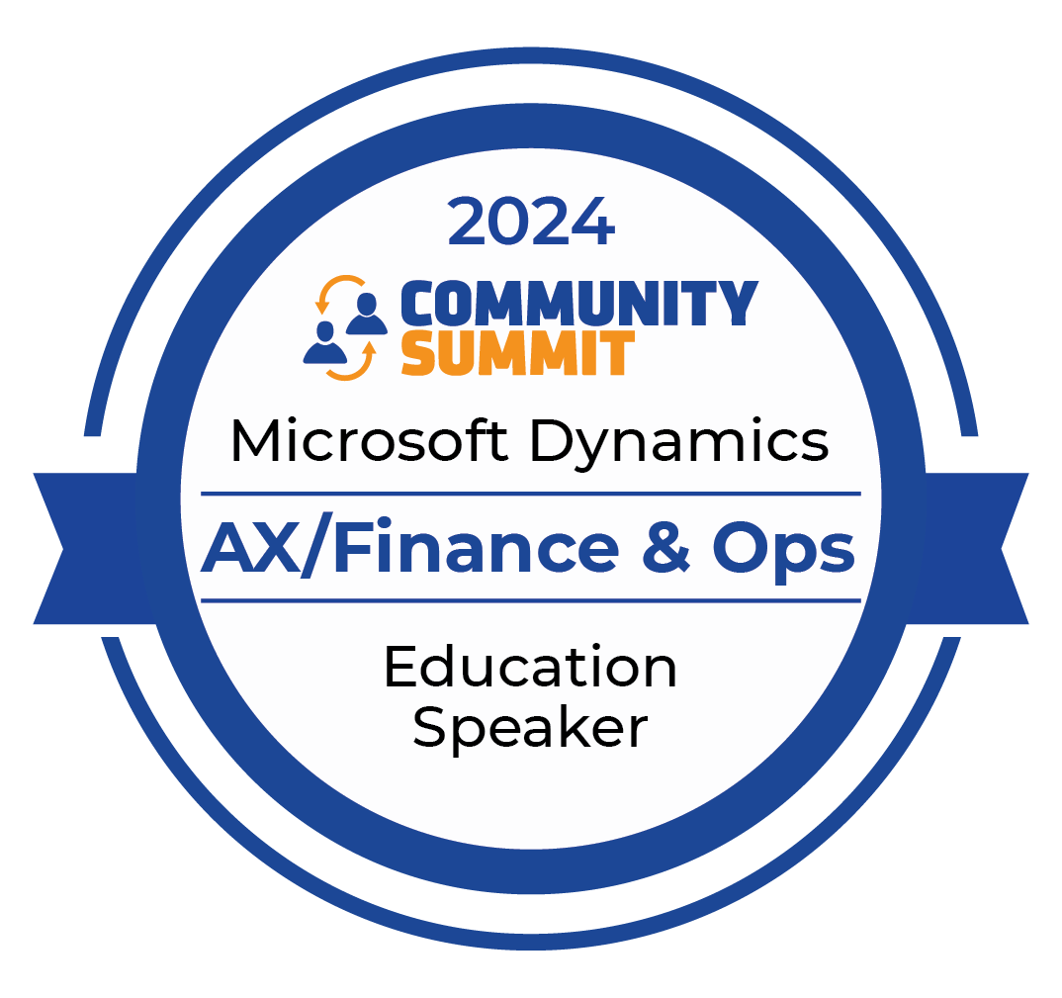
AX/FINANCE & OPS
San Antonio, Texas
October 13-17, 2024

Slide 2
Integrating Smarter: The New Era of Dynamics F&O and Power Platform

Slide 3


Nathan Clouse
Technical Architect
Armanino LLP
Email: nathan.clouse@armanino.com
Blog #1: https://www.atomicax.com
Blog #2: https://www.dynamics.fo
GitHub: https://github.com/NathanClouseAX
@NathanClouseAX on most platforms
Background:
Awarded Microsoft MVP in Business Applications since 2019
Been working with AX since 2009
Been working with D365FO since 2017
Have spoken at Summit, Focus, and local chapters around various AX/D365FO technical topics plus other groups events

Slide 4
Introduction
The Unified Development Environment (UDE)
The Unified Environment, Too!
Integration Methods
CI/CD
“The New Normal” – challenges and lessons learned
Best Practices
Q&A

Slide 5
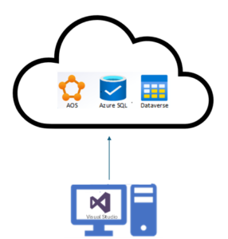
UDE Overview
“Unified Developer Experience for Finance and Operations apps”
Dual Write – F&O and Friends*
Virtual entities
Business Events / Data Events
Dataverse Plugins
Synapse Link
Notes:
Overview of the unified development environment that consolidates tools for F&O and Power Platform.

Slide 6
Notes:
Overview of the unified development environment that consolidates tools for F&O and Power Platform.

Slide 7
UDE Overview
“Unified Developer Experience for Finance and Operations apps”
Dual Write – F&O and Friends*
Virtual entities
Business Events / Data Events
Dataverse Plugins
Synapse Link
Notes:
Overview of the unified development environment that consolidates tools for F&O and Power Platform.

Slide 8
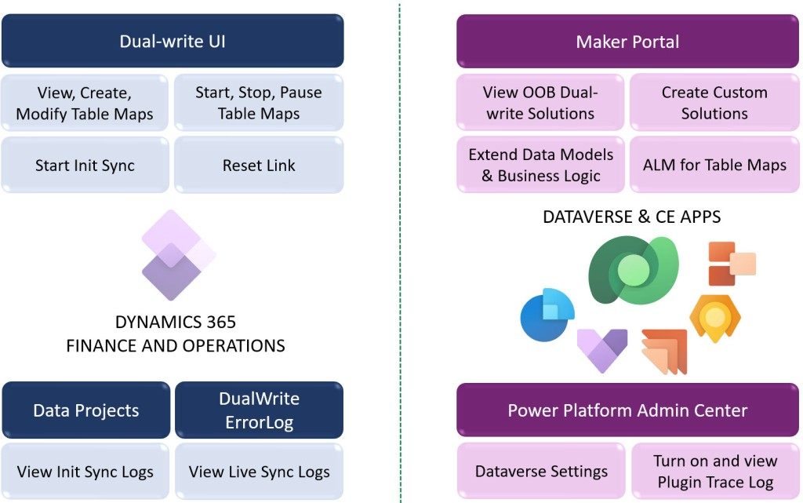
What’s in an environment now?
Notes:
https://carinaclaesson.com/2023/03/12/demystifying-dual-write/

Slide 9
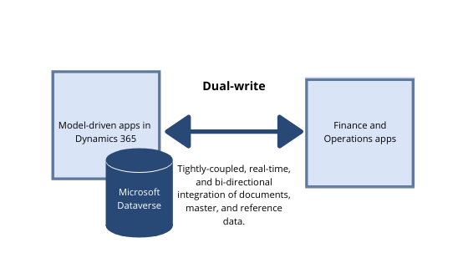
Dual Write
This allows you to synchronize data in near real time between the Dataverse and finance and operations environments.
Notes:
Explanation of key development tools, such as Visual Studio for F&O development and the Dataverse for data management.

Slide 10
Virtual Entities
This makes finance and operations tables available in Dataverse, without any data copying.
Remember OData?
“Exposed OData”
Notes:
Importance of metadata and code-based development for critical business processes https://learn.microsoft.com/en-us/power-platform/developer/unified-experience/finance-operations-dev-overview https://learn.microsoft.com/en-us/power-platform/admin/unified-experience/finance-operations-apps-overview

Slide 11
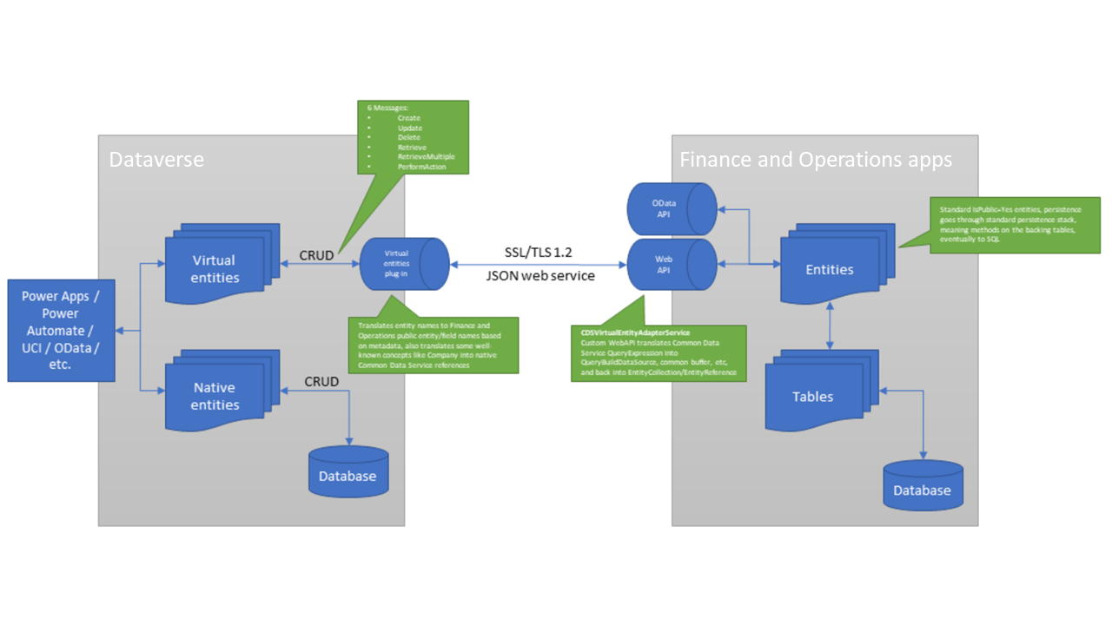

Slide 12
Business Events / Data Events
Send a message when an event occurs
Virtualized in Power Platform
Since Power Platform is there already, this just works
Notes:
Explanation of key development tools, such as Visual Studio for F&O development and the Dataverse for data management.

Slide 13
Dataverse Plug-ins / Apps
Apps and Plug-ins from Dataverse are also there next to F&O
F&O and related tools are now Dataverse Apps
Mandatory Mention: Even Copilot. X++ code and various other artifacts exposed to Copilot Studio
Notes:
Importance of metadata and code-based development for critical business processes https://learn.microsoft.com/en-us/power-platform/developer/unified-experience/finance-operations-dev-overview https://learn.microsoft.com/en-us/power-platform/admin/unified-experience/finance-operations-apps-overview

Slide 14
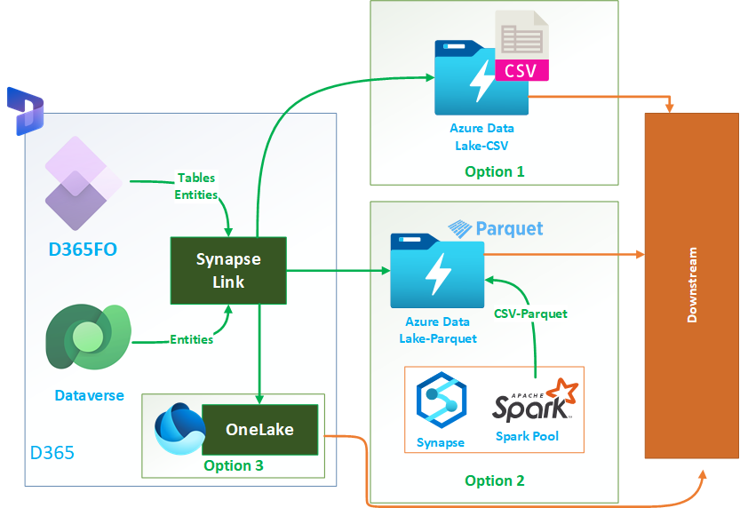
Synapse Link
F&O Tables and Entities available for export
Continuous replication using CUD events Options
COST
Notes:
https://azureintegrations.com/2023/10/21/export-data-from-d365-fo-using-synapse-link/

Slide 15
Notes:
https://azureintegrations.com/2023/10/21/export-data-from-d365-fo-using-synapse-link/

Slide 16
Synapse Link
F&O Tables and Entities available for export
Continuous replication using CUD events Options
COST
Notes:
https://azureintegrations.com/2023/10/21/export-data-from-d365-fo-using-synapse-link/

Slide 17
CHE vs UDE
Item | Customer Hosted Environment (CHE) | Online Development Environment
Azure subscription | Needs Azure subscription | NA
Security & compliance | Customer must manage | Microsoft would manage
Azure quota management | Customer must manage | NA
New environment setup time | 4 to 6 hours | Less than 2 hours
Service updates | Customer manages | Microsoft managed
Quality updates | Customer managed | Microsoft managed
Microsoft Power Platform/ Dataverse integration | Customer must manually integrate with CHE | Fully integrated environment
Service and quality updates rollback | Rollback not supported for failed updates | Full rollback support
Total Cost of Ownership (TCO) | Very high | Low
Copy production data to troubleshoot | Multi-step and multi-day process | Typically less than 4 hours
Deploy changes / customizations to cloud | Takes a few hours | Takes a few minutes
Customer Managed Keys enabled | Not possible | Available

Slide 18
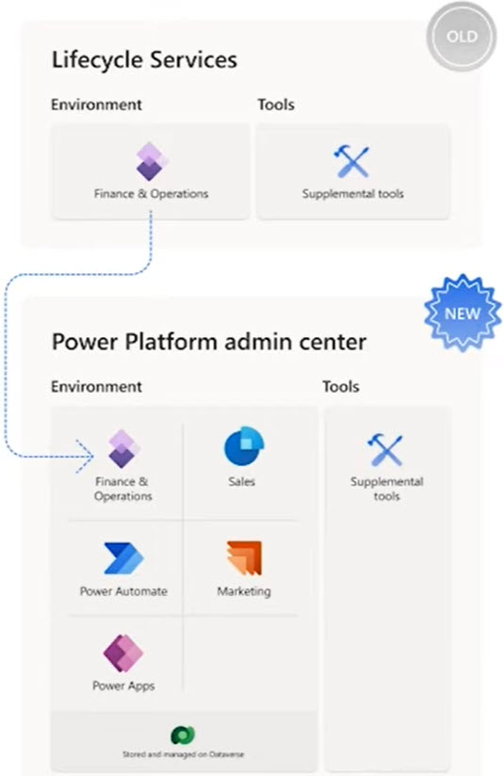

Slide 19
Unified Environment
1 Environment
All the Infrastructure for Dataverse, Dynamics 365 Apps ( not F&O), Plus F&O
No Dev Tools
“Normal” sandbox environment
Convert to Production when ready

Slide 20
Integration Methods
Don’t really change, just presented a little differently
Still have OData, Custom Services, etc for F&O
Still have OData for Power Platform
No new options, its all just there and known to each other
Notes:
Dual-write and Virtual Tables: Seamless data sync between Dataverse and Dynamics F&O in real-time. Example: How dual-write integrates data for finance and operations apps​ https://learn.microsoft.com/en-us/dynamics365/fin-ops-core/dev-itpro/power-platform/enable-power-platform-integration

Slide 21
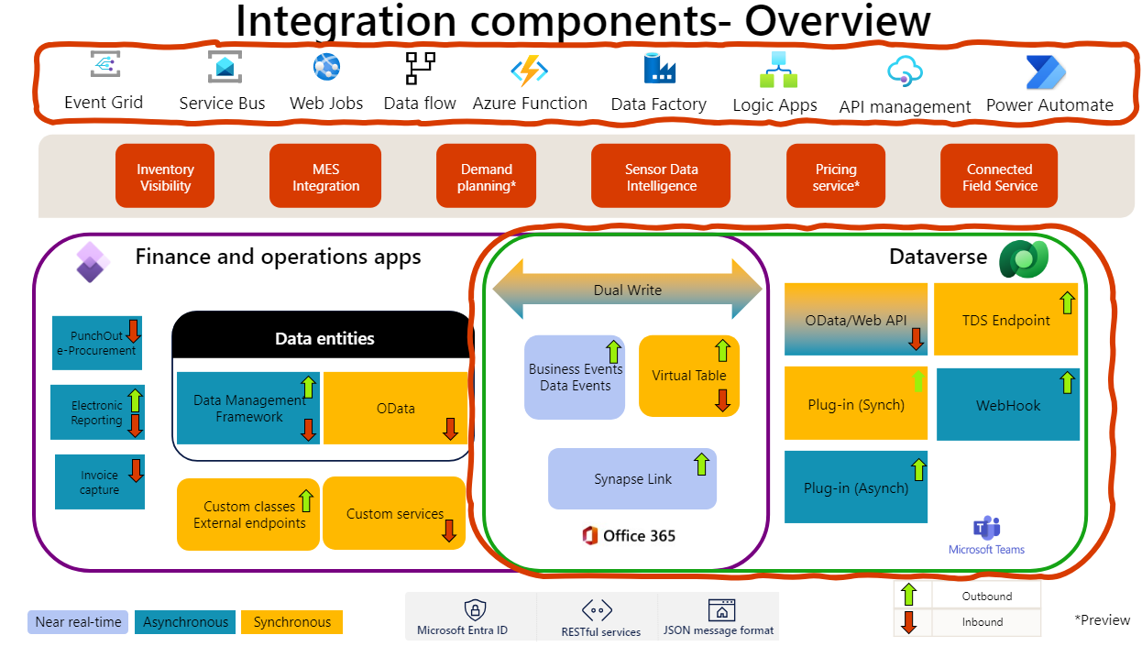
Notes:
https://learn.microsoft.com/en-us/dynamics365/guidance/techtalks/integrate-finance-operations-Dataverse

Slide 22
Notes:
https://learn.microsoft.com/en-us/dynamics365/guidance/techtalks/integrate-finance-operations-Dataverse

Slide 23
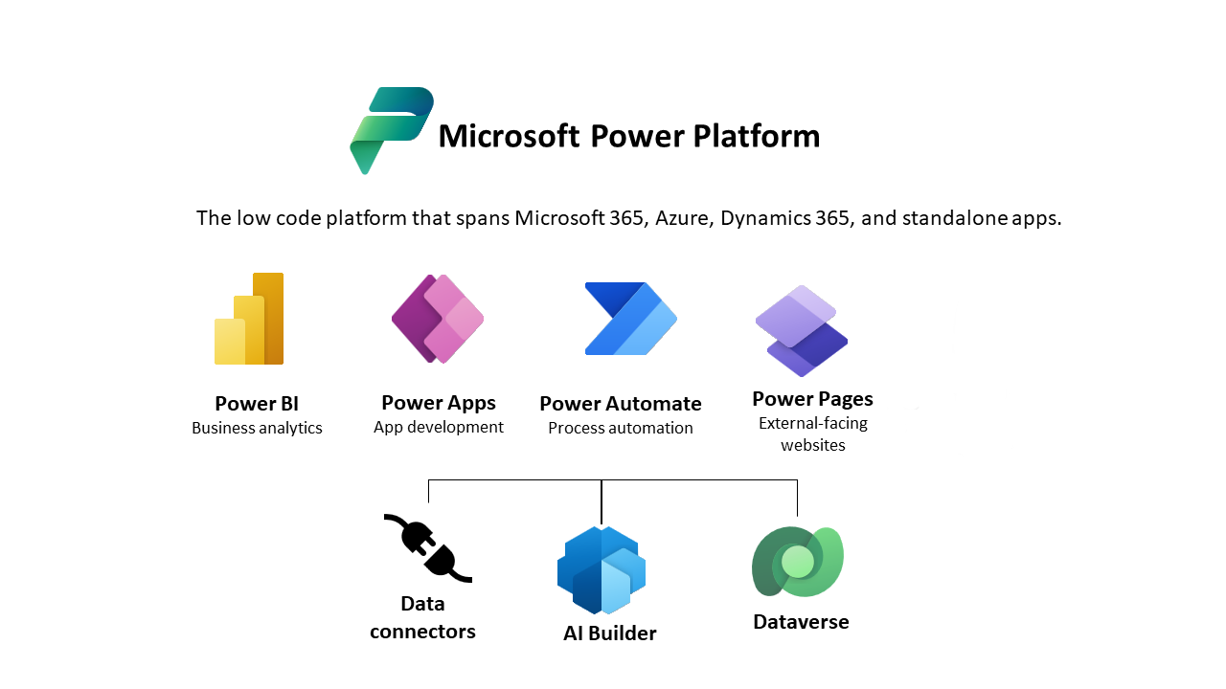
Integration: Power Platform
Notes:
Power Automate: Automating workflows that include both F&O and Power Platform elements.

Slide 24
Enabling Continuous Deployment
Provide a continuous integration and deployment (CI/CD) experience where you can build and deploy your solutions. The fully automatic deployment contains contributions from both Dataverse and Finance and Operations.
Notes:
Discussion of how to implement continuous integration and deployment (CI/CD) using Azure DevOps pipelines.

Slide 25
Enabling Continuous Deployment
Can use PowerShell to create/service environments
Can use Azure DevOps Pipelines for any number of activities like build, deploy, test, service, create, destroy, backup, restore, etc.
Why?
Notes:
Benefits of automating deployment cycles for F&O projects, reducing manual errors​
https://learn.microsoft.com/en-us/power-platform/admin/unified-experience/finance-operations-apps-overview
https://learn.microsoft.com/en-us/power-platform/developer/unified-experience/finance-operations-dev-overview

Slide 26
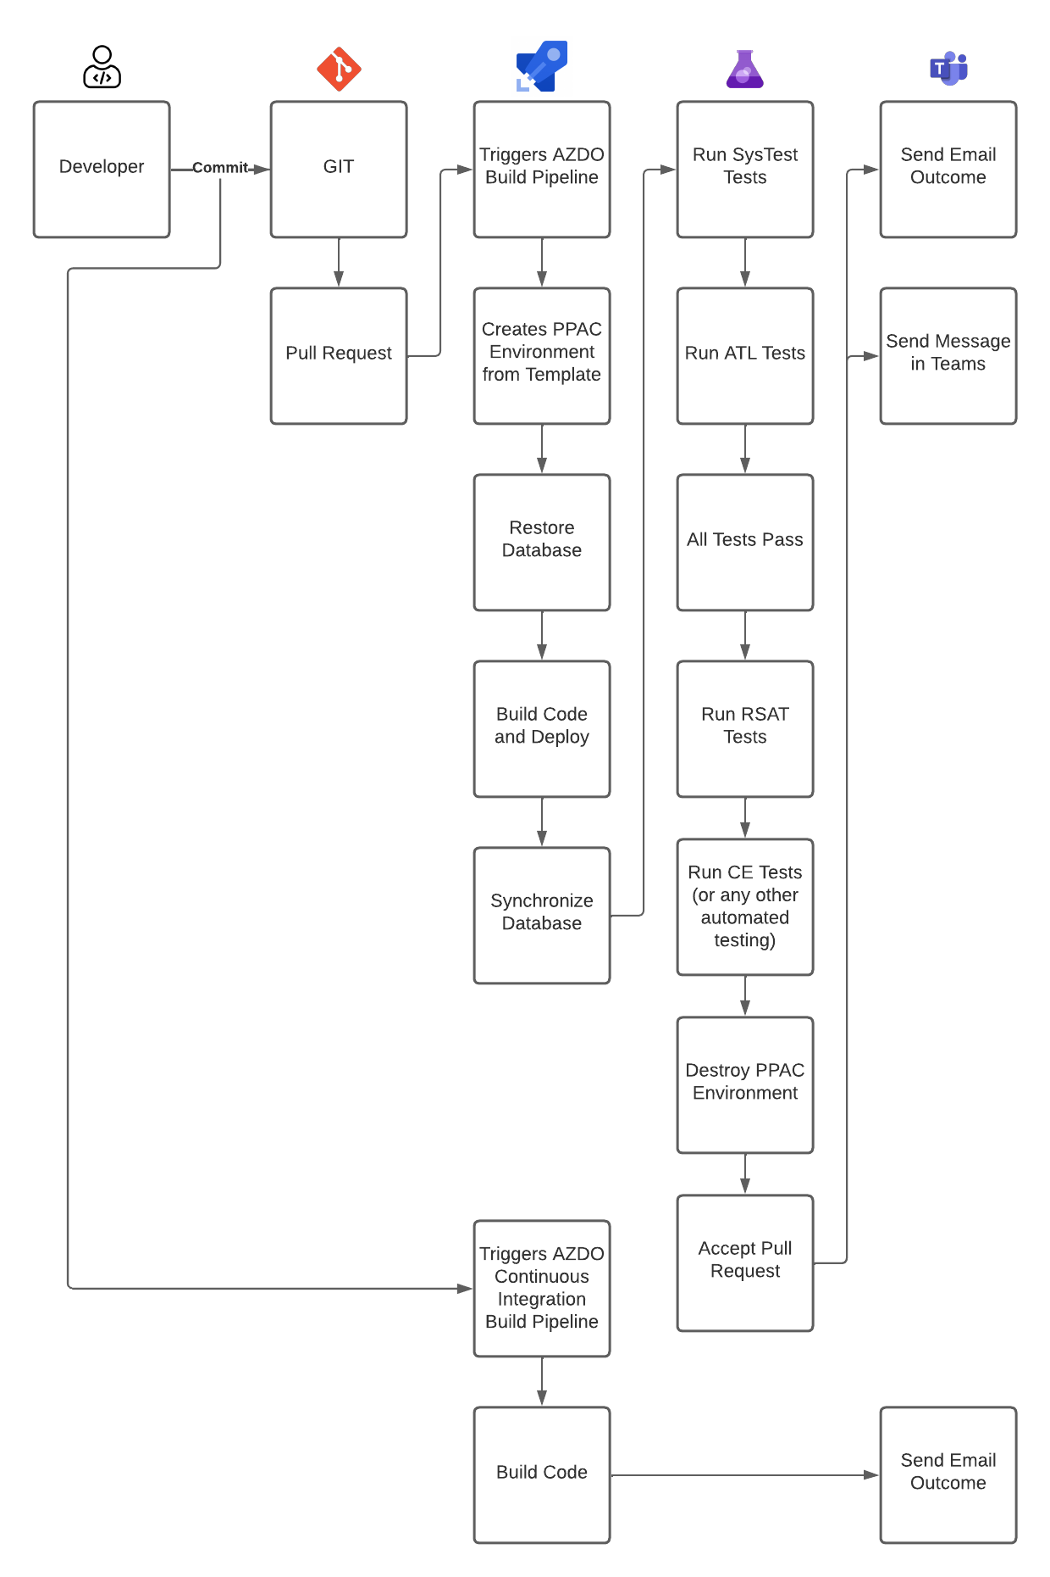

Slide 36
The New Normal
Data Management
Power Platform plus F&O Database together
Filters available to remove some data from a backup; ie full, “transactionless”, maybe more to come
Just In Time Data Access
Can get SQL access if required using VS plus SSMS
Same capabilities as LCS, different interface

Slide 37
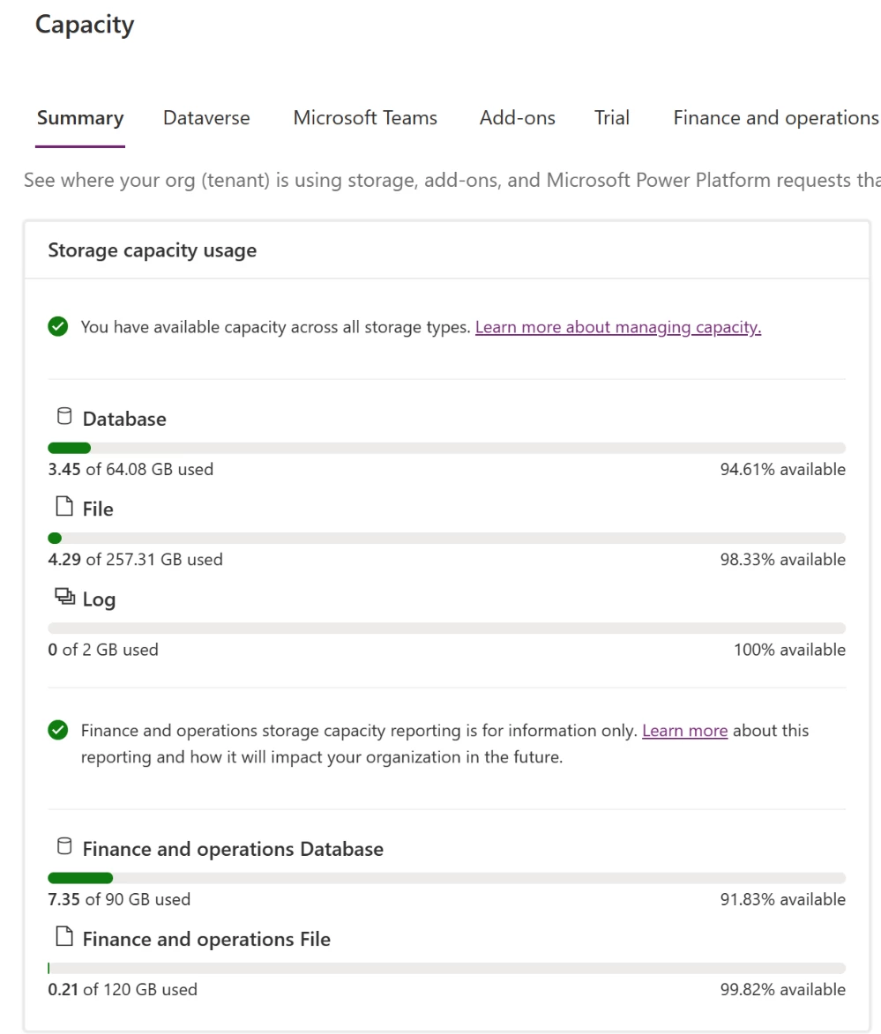
Storage Based Provisioning Model

Slide 38
Notes:
Every new environment requires at least 1 gigabyte (GB) of available storage for both Dataverse and Operations database capacity to deploy. Capacity is granted from finance and operations apps user licenses, sandbox add-on purchases, as well as add-on capacity packs

Slide 39
Lessons Learned
Plan
And then plan more – Have known supports flows and scenarios
Keep in mind: It is F&O Plus Power Platform (if you use CE, etc)

Slide 40
Planning
Partner Center – Delegated Admin
Development – Guest accounts
Monitoring for everything Power Platform is now Application Insights in Azure
LCS is going to die, the end is near-ish
Notes:
How to optimize the unified experience, leveraging sandbox and production environments

Slide 41
Scaling
Tiering is no longer a thing
All environments are of equal “size”
Sandbox and Production will have the same auto-scale limit
Set based on user licenses plus add-on packs summed at tenant
Deploy as many as you have storage capacity including production
Convert Sandbox to Production on demand
Notes:
https://community.dynamics.com/blogs/post/?postid=2f6a488e-3319-ef11-9f89-000d3a4fa3e0

Slide 42

Q&A

Slide 43
Resources
https://devblogs.microsoft.com/powerplatform/the-unified-development-environment-is-ga/
https://www.youtube.com/watch?v=OuEZ1rXkpYY
https://www.microsoft.com/en-us/dynamics-365/blog/it-professional/2023/09/15/announcing-unified-trial-and-developer-environments-for-dynamics-365-finance-and-operations-apps/

Slide 45
AX/FINANCE & OPS
© 2024 Dynamic Communities. All rights reserved.

